Slide 1
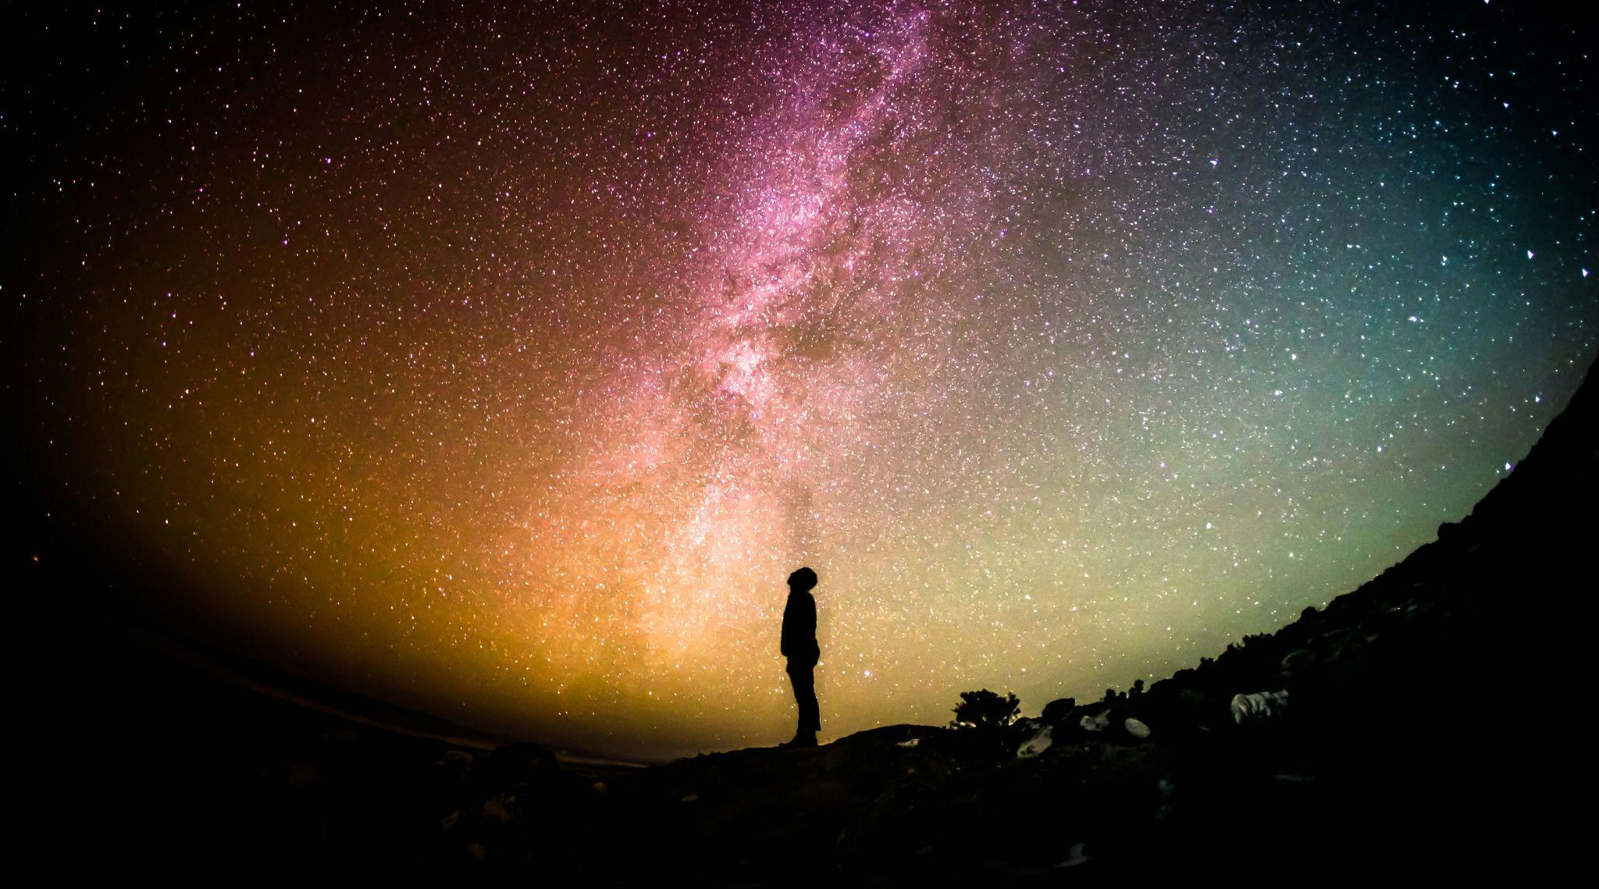


High energy neutrinos
from SN explosions
V. Oliviero, I.C. Rea and M. Bendahman
WP7 meeting 27-28/11/2024

Slide 2
Overview
High-energy neutrinos from SNe
Why is it important to study H-E neutrinos from CCSN?
Our goal: sensitivity studies for H-E neutrinos from SNe
First approach: time dependent Unbinned Likelihood using Aanet
Preliminary Studies: model, source catalogue, calculation of expected neutrino events for ARCA21
Oliviero, Rea, Bendahman

Slide 3
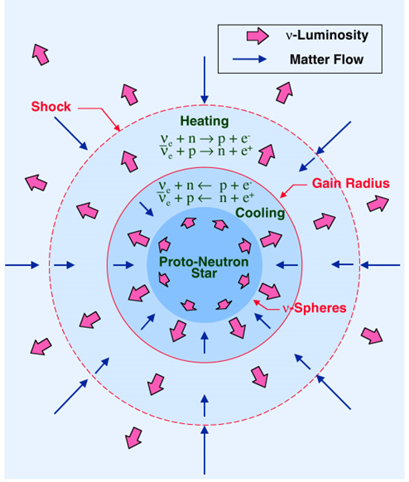
High-energy neutrinos from SNe
The core-collapse supernovae (CCSNe) explosion mechanism is driven by low energy (MeV) neutrinos, which release most of the system's gravitational binding energy.
In addition to MeV neutrinos, some CCSNe are good candidates for the production of high-energy (H-E) neutrinos (from GeV to PeV)
We consider two production mechanisms
for H-E neutrinos in CCSNe:
interaction between SN ejecta and CSM
(Murase 2018)
relativistic choked jets
(Enberg et al. 2009)
Oliviero, Rea, Bendahman
Notes:
The CSM provides target material for the ejecta to form shocks and accelerate protons with matter via hadronuclear (pp interaction) or photohadronic (pγ) mechanism. / In this scenario the proposed progenitors are similar to gamma-ray bursts (GRBs), except the jets are slower and never break through the stellar envelope, leading to neutrinos without the counterpart gamma-ray emission.

Slide 4
Why is it important to study H-E neutrinos from CCSN?
Neutrino telescopes such as the IceCube Neutrino Observatory and KM3NeT observe the burst of MeV neutrinos from CCSNe as single photon hits from interactions that occur near the PMTs.
In addition, the potential to extend the detection horizon can be done only through detecting H-E neutrinos
This measurement is quite sensitive to the high level of single photon noise (dark noise of K40 in the seawater or glass)
SNe CANDIDATES
H-E 𝝂 could give us an insight into the CR acceleration processes (inaccessible with the L-E 𝝂)
CSM interaction candidates: SN type IIn and II-P
Relativistic CJs candidates: SN type Ib/c and IIb
Oliviero, Rea, Bendahman
Notes:
his measurement is quite sensitive to the high level of single photon noise (dark noise of K40 in the seawater or glass) limiting the ability for neutrino telescopes to observe faint signals from CCSNe.

Slide 5
Sensitivity studies for H-E 𝝂 from SNe
OUR GOAL
Estimation of the sensitivity for different configurations of ARCA detector to H-E 𝝂 coming from SN explosion.
Time dependent unbinned Likelihood using Aanet
Cut&Count analysis
Two approaches to be compared:
Study the SN neutrinos emission model
Evaluation of the expected number of neutrino events using the model and different configurations of ARCA
We started with preliminary studies that are mandatory for both approaches
Oliviero, Rea, Bendahman
For the moment, we started investigating on the time dependent unbinned analysis…

Slide 6
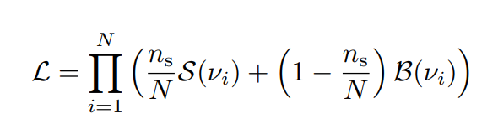
Time dependent Unbinned Likelihood using AANET
In order to find an excess of 𝝂 from given SN positions and times, we chose to follow a time dependent point source likelihood method as described in
“Constraining High-Energy Neutrino Emission from Supernovae with IceCube”
The Likelihood function is given by
Where S(𝝂) and B(𝝂) are PDF respectively for signal and background
Oliviero, Rea, Bendahman

Slide 7


Time dependent Unbinned Likelihood using AANET
The signal PDF (same for BKG PDF) is a product of 3 terms
The signal time PDF Ts corresponds to the expected neutrino flux as a function of time (light curve); the bkg time PDF Tb assumes a constant background rate.
Spatial term
(2D Gauss)
Expected neutrino energy spectrum
Time term
(light curve)
Longer neutrino emission would be expected under the scenario of CSM interaction: it would be necessary to test all SN types with box function PDFs of different lengths, up to 1000 days possibly.
The SNe IIn and IIP light curves are going to be tested with the formula:
Oliviero, Rea, Bendahman
Meriem is working on implementing this term in the Unbinned Likelihood framework
Notes:
Tpp is a characteristic time scale constant

Slide 8
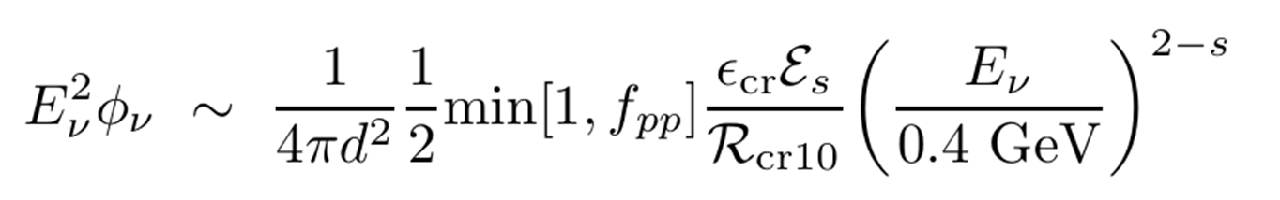
Preliminary studies
We started focusing on H-E neutrinos from CSM interaction production mechanism:
1) Model:
The model used for our studies is the one described in the Murase’s works ([1], [2])
The neutrino energy fluence is described as follows:
2) Sources catalogue:
Producing the catalogue consists of
selecting SNe Type II (IIn or IIP);
choosing the sources according to the life time of ARCA (from ARCA6 to ARCA21);
selecting the declinations in the range from -90° to 40° (according to KM3NeT field of view)
Fraction of energy carried by CR
Spectrum dependent factor
}
Proton momentum index
Spectrum dependent factor
pp optical depth
Oliviero, Rea, Bendahman
Notes:
About the CSM : Optical observations of various types of extragalactic SNe have provided cumulative evidence that a SN progenitor commonly experiences a significant mass loss, just before the explosion. As result shock interactions with CSM should occur.
This kind of mechanism is well explained in Murase’s works.
Also, Es and Rcr10 is a spectrum dependent factor that converts the bolometric CR energy to the differential CR energy
At the same time we are producing the catalogue. To do so, the guidelines we followed are ->

Slide 9
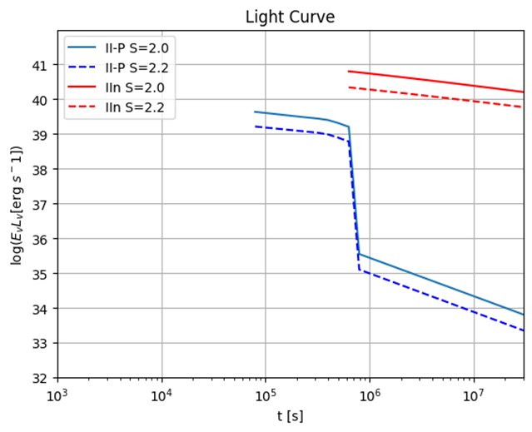
1.a) Model of the Light Curve
To reproduce the light curves of SN IIn and IIP we used the neutrino flux by Murase’s simulation: (https://github.com/pegasuskmurase/ModelTemplates/tree/main/SNHEMM)
Firstly, we managed to reproduce the differential neutrino luminosity vs. time for IIn and II-P type SN
(fig. 1 from the paper [1])
The light curves in the plot are drown selecting fixed 𝝂 energy
E𝝂 = 1TeV
*both proton momentum index (s=2.0 and s=2.2)
Oliviero, Rea, Bendahman

Slide 10
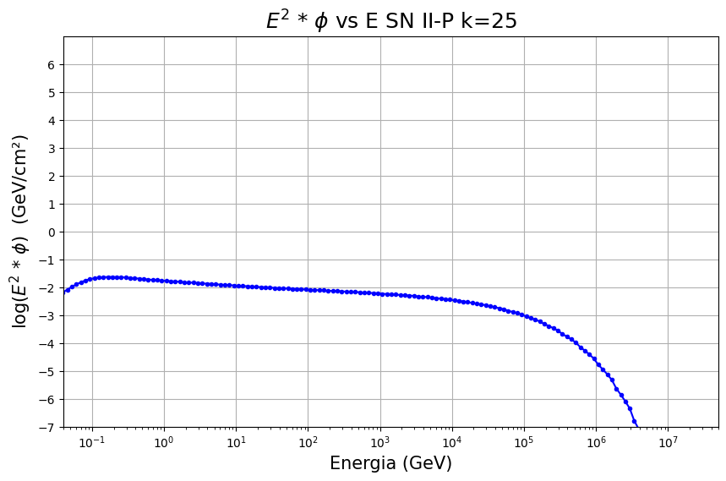
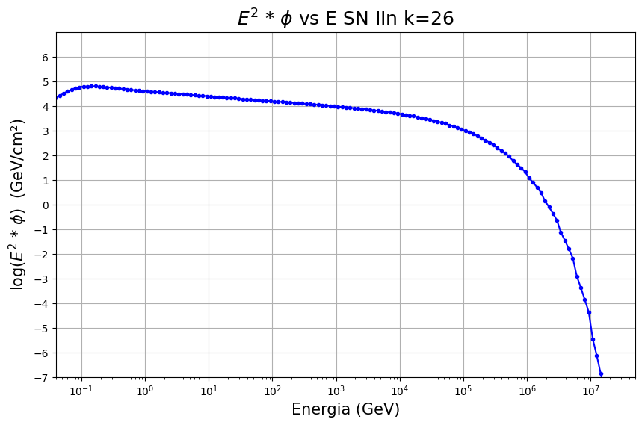
1.b) Model of the Fluence
We also reproduced the fluences of neutrinos for both type of SN, considering the time t_𝝂max as the time when the significance of neutrino emission is maximized.
(See fig. 2 right from the paper [2])
Oliviero, Rea, Bendahman

Slide 11
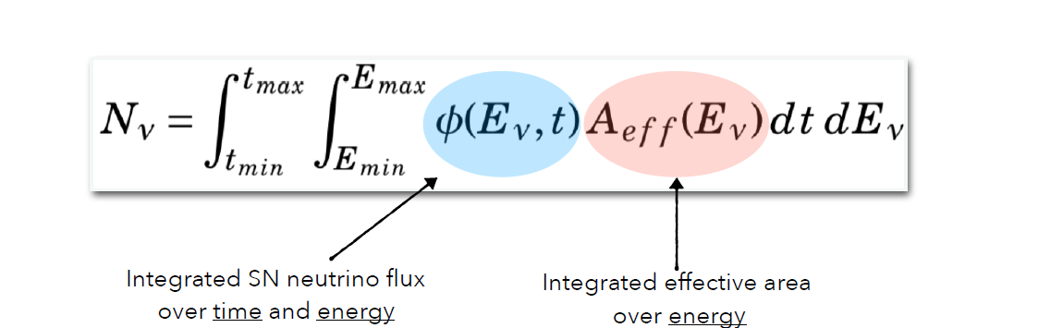
1.c) Number of expected events
The light curves will be used for the time-dependent unbinned likelihood (signal time PDF)
In the meanwhile, we have been focusing on reproducing the expected number of neutrinos, considering time range correspondent to the H-E neutrino emission as predicted in the Murase model.
Duration of the H-E neutrino emission
Oliviero, Rea, Bendahman

Slide 12
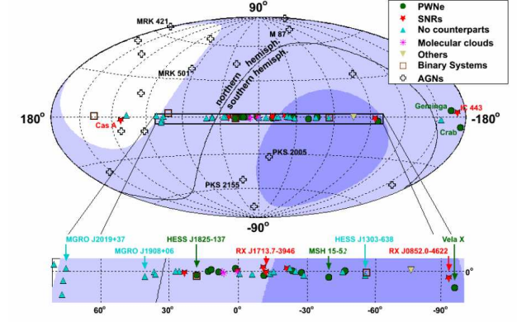
2.a) ARCA21 effective area for point source
We considered the effective area at different declinations. In particular, we computed the Aeff for the declination in the range [-90°, 40°], considering the southern hemisphere.
>25%
>75%
Oliviero, Rea, Bendahman

Slide 13
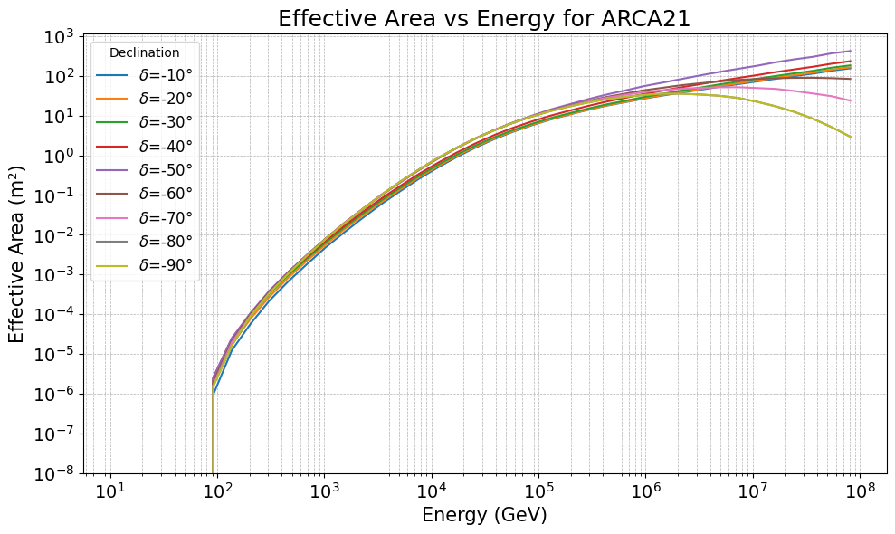
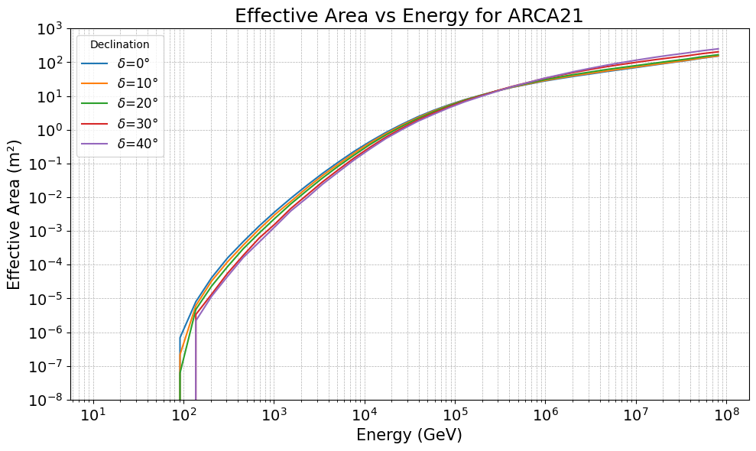
2.a) ARCA21 effective area for point source
Negative declinations
Positive declinations
Oliviero, Rea, Bendahman

Slide 14
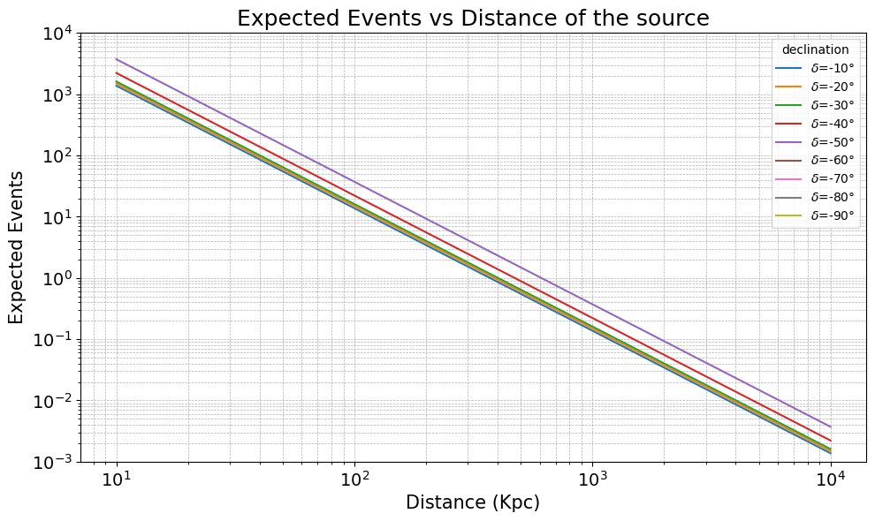
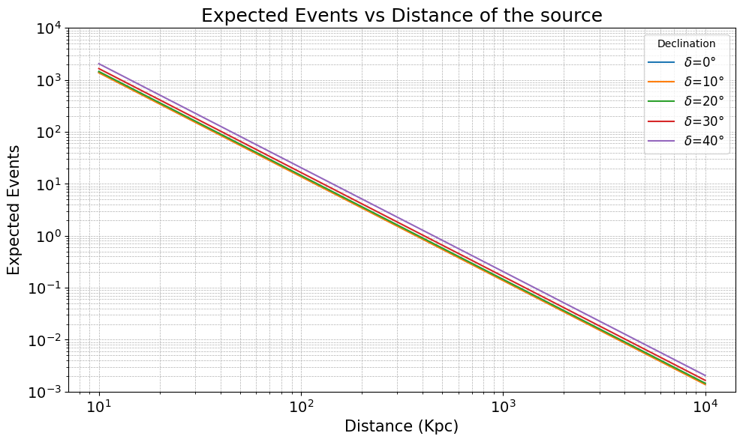
2.b) Number of expected events (SN type IIn)
We chose to plot the number of events vs. the source distance in a range from 10 Kpc to 10 Mpc, for each declination —> SN type IIn
ARCA21
ARCA21
Number of expected events for sources at negative declination
Number of expected events for sources at positive declination
Oliviero, Rea, Bendahman
Notes:
As we can see from these plots , the number of neutrino events does not depends significantly on the declination . Instead we have a strong dependence on the distance of the sources. From these preliminary studies we see that we can reach a detection horizon of about hundreds kpc for a IIn sn

Slide 15
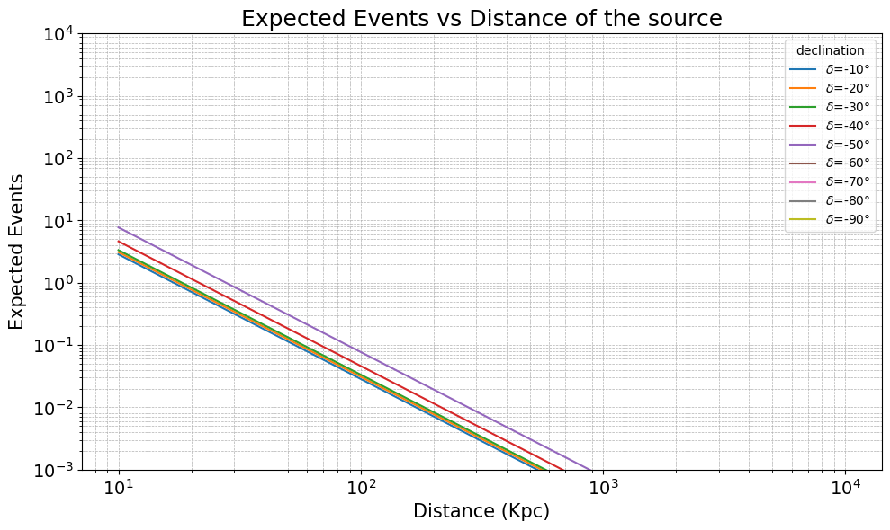
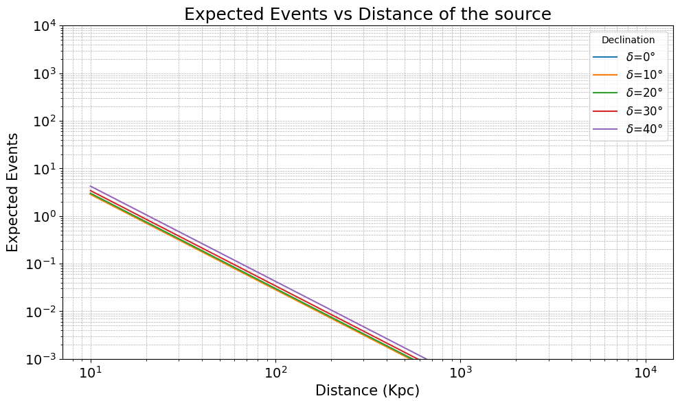
2.b) Number of expected events (SN type IIP)
We chose to plot the number of events vs. the source distance in a range from 10 Kpc to 10 Mpc, for each declination —> SN type IIP
ARCA21
ARCA21
Number of expected events for sources at negative declination
Number of expected events for sources at positive declination
Oliviero, Rea, Bendahman
Notes:
Meanwhile for a IIp SN the number of expected events is lower in general, and with ARCA21 configuration we can see something considering the sources in a range of tens kpc from us. These results are in agreement with the theoretical model. As showed before in the fluence plots, we expect a lower energy fluence and also luminosity for a type IIp SN.
We expect these estimation to increase with the future arca configuration

Slide 16
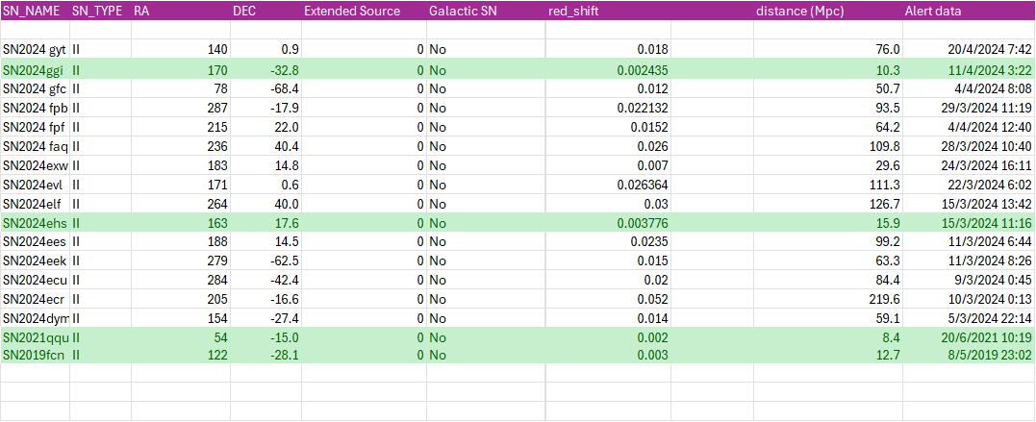
2.c) Sources catalogue
At the moment, the catalogue contains a bunch of SNe exploded in the entire ARCA lifetime (from ARCA6 to ARCA21) but we need to select them more carefully according to each ARCA period!
Only a few sources are closer than 10 Mpc!
Oliviero, Rea, Bendahman
Notes:
one reason why this study was crucial
We collected a bunch of sources in the catalogue, considering the guideline as said before , but ..
Of course we will increase the detection horizon with the future configuration of arca and with the final one, but at the moment it’s more useful for the studies to be focused on the sources that we have in 10 Mpc from us.

Slide 17
2.d) Expected events from sources in the catalogue
Considering the closest sources from the catalogue, we tried to compute the number of expected events.
For the moment, we have selected only the SN whose H-E neutrino emission occurs in a time window compatible with ARCA21 life time.
 | Declination (°) | Distance (Mpc) | #expected_events
SN2023ixf | 54° | 6.4 Mpc | 10⁻⁷
We will compute the number of expected events also for the SNe occurred during the life time of the other ARCA configurations (ARCA6, ARCA9 and ARCA19)
Oliviero, Rea, Bendahman

Slide 18
Next steps
Upgrade the catalogue;
Study of the sensitivity using Aanet unbinned likelihood;
Perform a Cut&Count analysis.
Thanks for your attention!
Any suggestions?
Oliviero, Rea, Bendahman

Slide 19
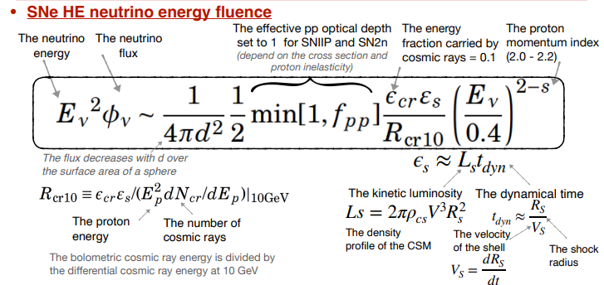
Back up

Slide 20
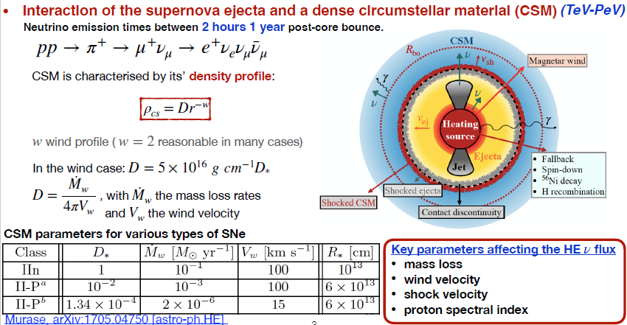
Back up

Slide 21
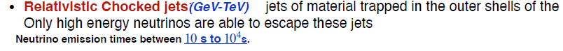
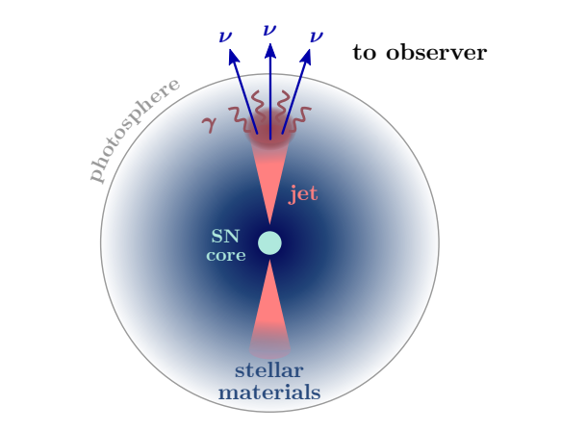
Back up
In this scenario the proposed progenitors are similar to gamma-ray bursts (GRBs), except the jets are slower and never break through the stellar envelope, leading to neutrinos without the counterpart gamma-ray emission.
Notes:
In this scenario the proposed progenitors are similar to gamma-ray bursts (GRBs), except the jets are slower and never break through the stellar envelope, leading to neutrinos without the counterpart gamma-ray emission.

